Slide 1
Linear Regression with ecommerce data
By: Keside Unegbu

Slide 2
Introduction
Congratulations! You just got some contract work with an Ecommerce company based in New York City that sells clothing online, but they also have in-store style and clothing advice sessions. Customers come into the store, have sessions/meetings with a personal stylist, then they can go home and order either on a mobile app or website for the clothes they want. The company is trying to decide whether to focus their efforts on their mobile app experience or their website. They've hired me on contract to help them figure it out! Let's get started!

Slide 3
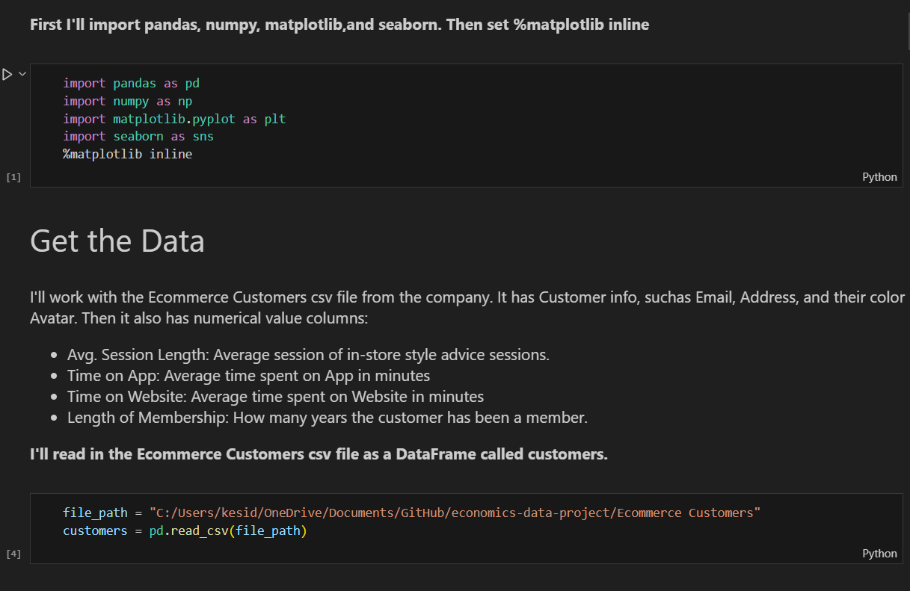
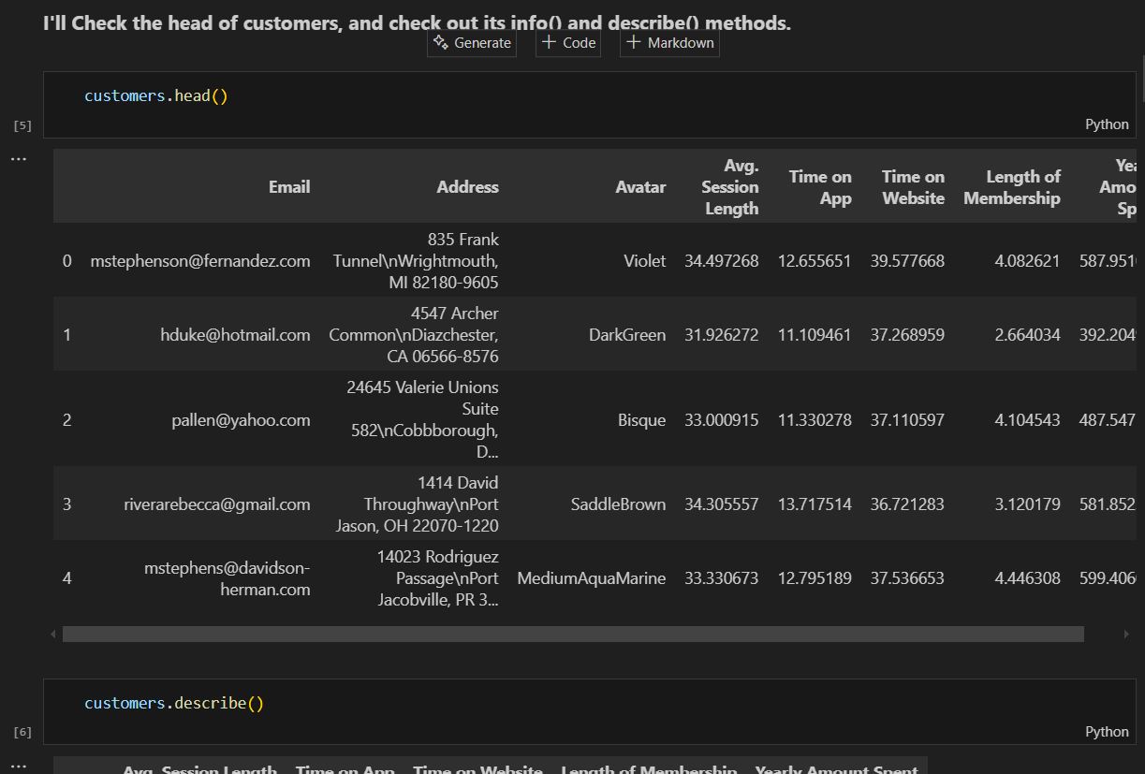
Data imports and exploration
I import all the libraries I need to do data analysis and visualization.
I also used the head() method to bring me the first 5 rows of the data set

Slide 4
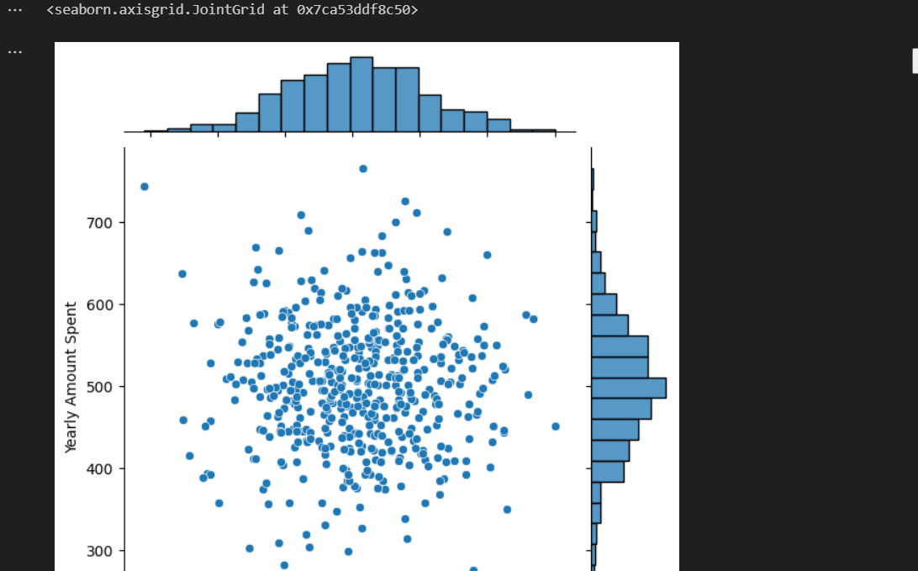
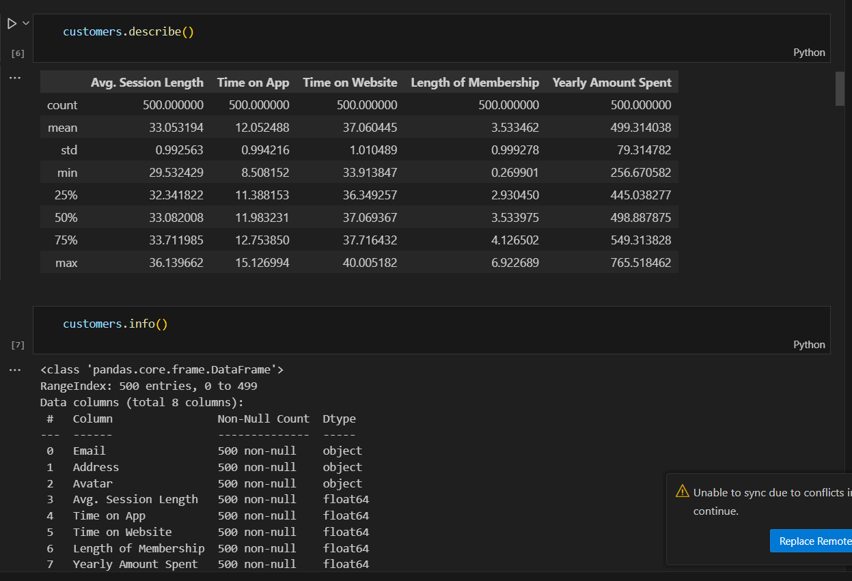
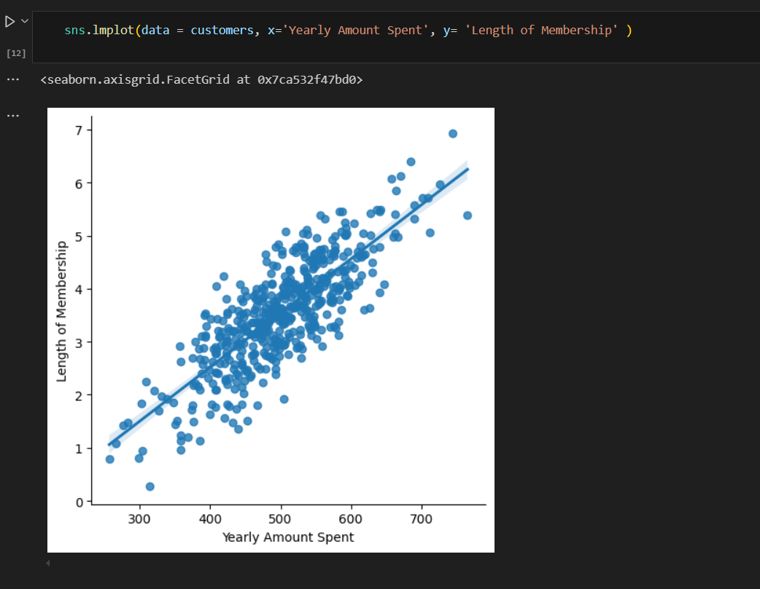
Exploring the data and visualization
Used the describe and info to get a little more information about the dataset.
Used Seaborn to create a joint plot between the time spent on the Website and Yearly amount spent.
Also used seaborn to create a linear plot between the Length of membership and the Yearly amount spent

Slide 5
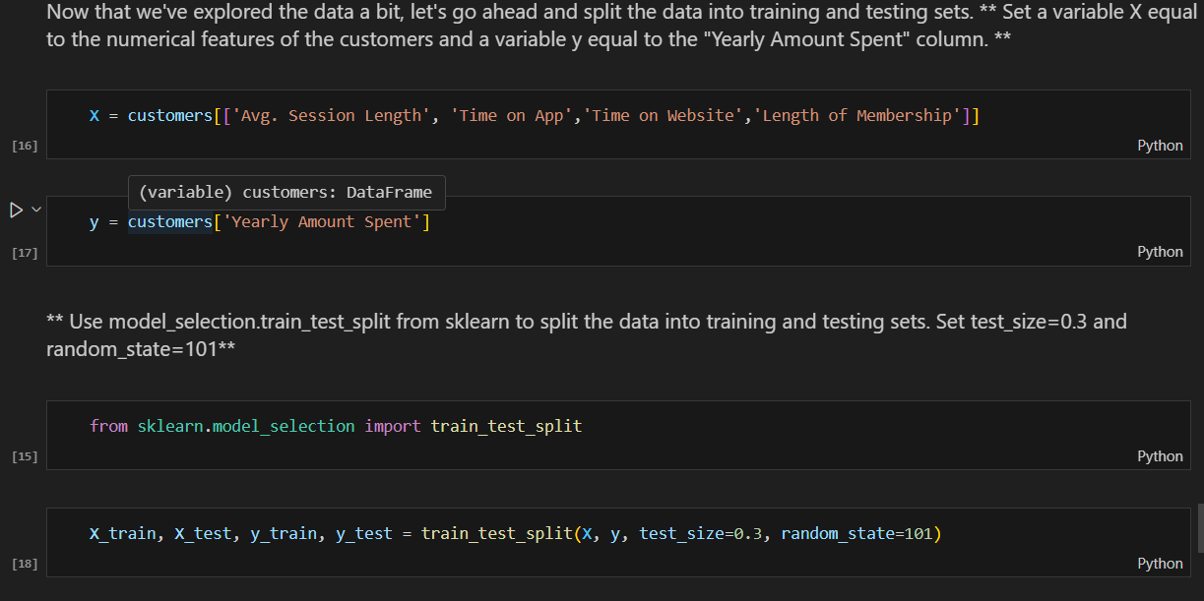
Setting Up my model for training

Slide 6
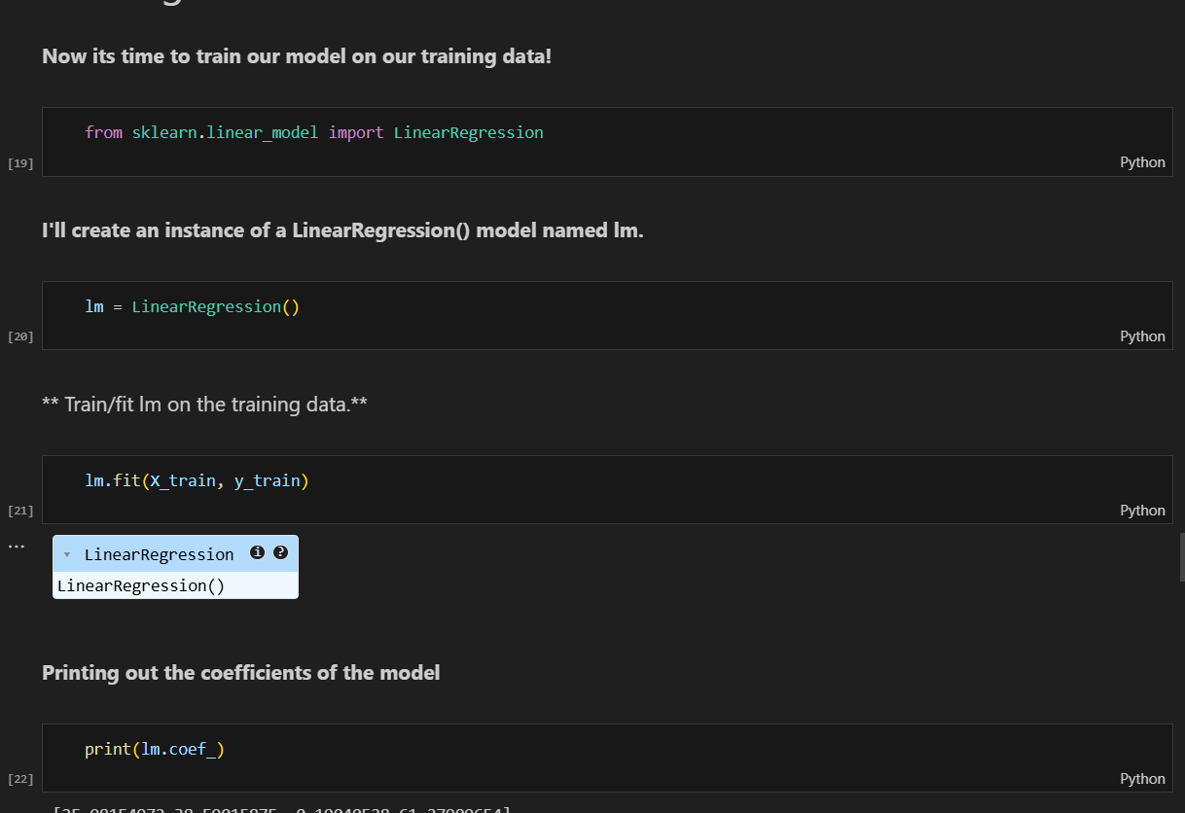
Training my model

Slide 7
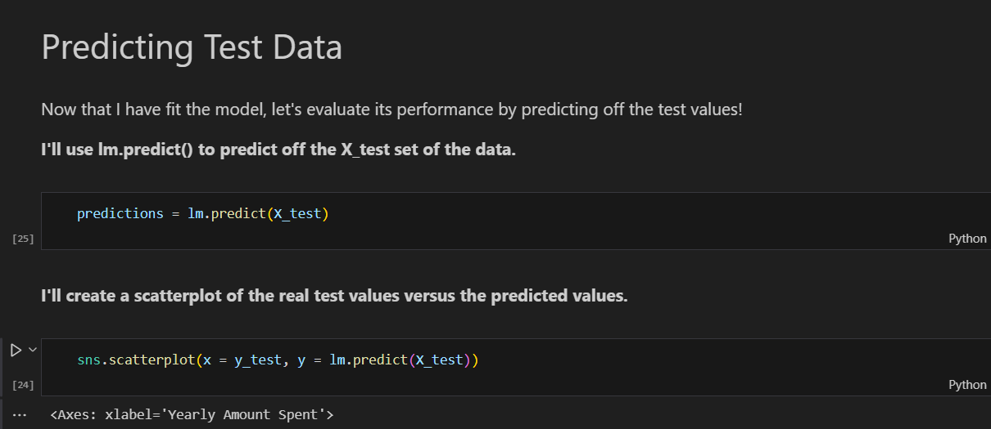
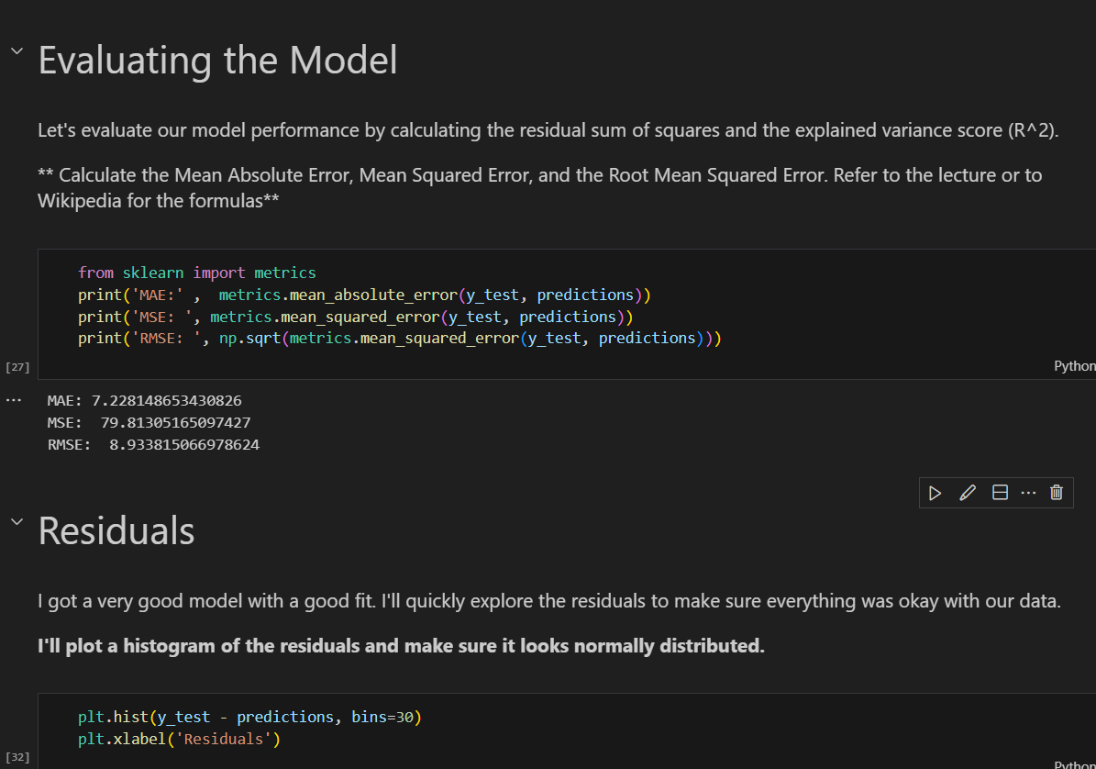
Predicting and evaluation

Slide 8
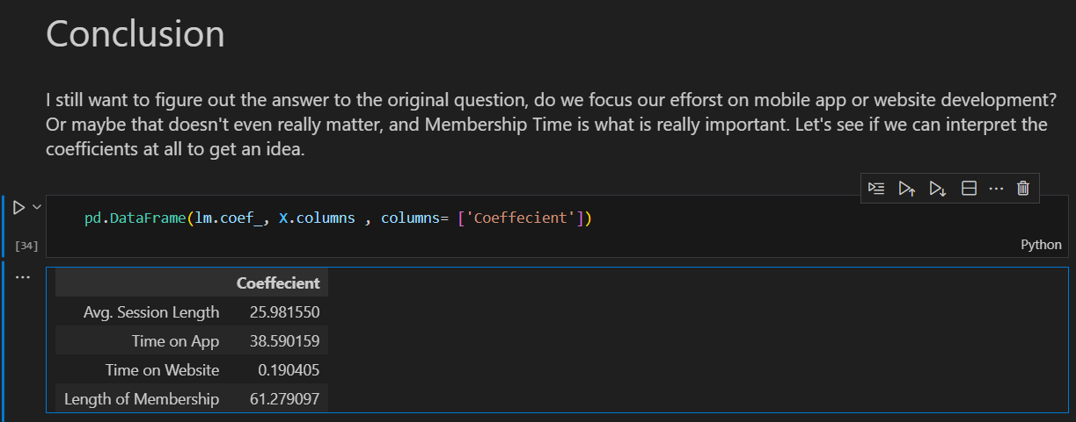
Conclusion
The model coefficients show the impact of each feature on yearly customer spending. Typically, Time on App has a higher positive coefficient than Time on Website, indicating that increasing the time customers spend on the app is more strongly associated with higher yearly spending. Additionally, Length of Membership also shows a strong positive relationship with spending, suggesting that retaining customers and encouraging longer memberships is highly valuable.

